Slide 1

C++14 Concepts
Bjarne Stroustrup
Texas A&M University
www.stroustrup.com

Slide 2
Templates
Primary aim: to support efficient generic programming
Uncompromised generality
Should do far more than I could imagine
Uncompromised performance
User-defined vector should compete with built-in array
Good interfaces
Well, two out of three ain’t bad ☹
Provides compile-time duck typing

Slide 3
Duck Typing is Insufficient
There are no proper interfaces
Leaves error detection far too late
Compile- and link-time in C++
Encourages a focus on implementation details
Entangles users with implementation
Leads to over-general interfaces and data structures
As programmers rely on exposed implementation “details”
Does not integrate well with other parts of the language
Teaching and maintenance problems
We must think of generic code in ways similar to other code
Relying on well-specified interfaces (like OO, etc.)

Slide 4
Generic Programming is “just” Programming
Traditional code
double sqrt(double d); // C++84: accept any d that is a double
double d = 7;
double d2 = sqrt(d); // fine: d is a double
double d3 = sqrt(&d); // error: &d is not a double
Generic code
void sort(Container& c); // C++14: accept any c that is a Container
vector<string> vs { “Hello”, “new”, “World” };
sort(vs); // fine: vs is a Container
sort(&vs); // error: &vs is not a Container

Slide 5
Remember C++0x Concepts?
Could express requirements of all standard library algorithms
Could check calls
Could check definitions
Could map names in calls
Was object-oriented in nature
Somewhat similar to Haskell type classes (but more general)
Is dead
A debacle of complexity
120 “concepts” in the standard library
73 pages of specification (more than C++85)
Compilation required heroic efforts
To re-gain run-time performance (done)
To re-gain compilation speed (not done)
Not as general/flexible as I would like
Parts, I couldn’t understand

Slide 6
Back to square #1
First
What are concepts?
What concepts are there?
How do we use concepts?
Finally
what language support do we need?
What language support can we afford
No runtime overhead
done
Max 20% compile-time overhead
We do much better than that: faster than workarounds

Slide 7
C++14: Constraints aka “Concepts lite”
How do we specify requirements on template arguments?
state intent
Explicitly states requirements on argument types
provide point-of-use checking
No checking of template definitions
use constexpr functions
Voted as C++14 Technical Specification
Design by Bjarne Stroustrup, Gabriel Dos Reis, and Andrew Sutton
Implemented by Andrew Sutton in GCC
There are no C++0x concept complexities
No concept maps
No new syntax for defining concepts
No new scope and lookup issues

Slide 8
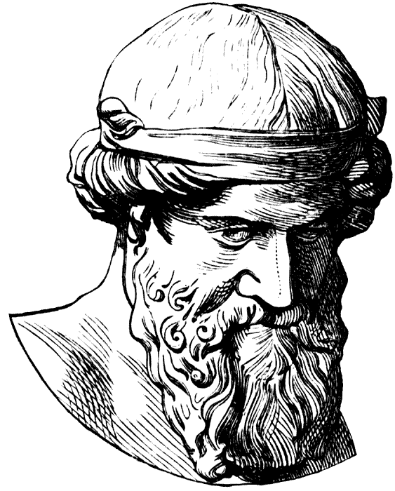
What is a Concept?
Concepts are fundamental
They represent fundamental concepts of an application area
Concepts are come in “clusters” describing an application area
A concept has semantics (meaning)
Not just syntax
Operations are related (e.g., +, -, *, and %)
“Subtractable” is not a concept
We have always had concepts
C++: Integral, arithmetic
STL: forward iterator, predicate
Informally: Container, Sequence

Slide 9
What is a Concept?
A concept is not the minimal requirements for an implementation
An implementation does not define the requirements
Requirements should be stable
Concepts support interoperability
There are relatively few concepts
We can remember a concept

Slide 10
C++14 Concepts (Constraints)
A concept is a predicate on one or more arguments
E.g. Sequence<T>() // is T a Sequence?
Template declaration
template <typename S, typename T>
requires Sequence<S>()
&& Equality_comparable<Value_type<S>, T>()
Iterator_of<S> find(S& seq, const T& value);
Template use
void use(vector<string>& vs)
{
auto p = find(vs,"Jabberwocky");
// …
}

Slide 11
C++14 Concepts: “Shorthand Notation”
Shorthand notation
template <Sequence S, Equality_comparable<Value_type<S>> T>
Iterator_of<C> find(S& seq, const T& value);
We can handle essentially all of the Palo Alto TR
(STL algorithms) and more
Except for the axiom parts
We see no problems checking template definitions in isolation
But proposing that would be premature (needs work, experience)
We don’t need explicit requires much (the shorthand is usually fine)

Slide 12
C++14 Concepts: Error handling
Error handling is simple (and fast)
template<Sortable Cont>
void sort(Cont& container);
vector<double> vec {1.2, 4.5, 0.5, -1.2};
list<int> lst {1, 3, 5, 4, 6, 8,2};
sort(vec); // OK: a vector is Sortable
sort(lst); // Error at (this) point of use: Sortable requires random access
Actual error message
error: ‘list<int>’ does not satisfy the constraint ‘Sortable’

Slide 13
C++14 Concepts: Overloading
Overloading is easy
template <Sequence S, Equality_comparable<Value_type<S>> T>
Iterator_of<S> find(S& seq, const T& value);
template<Associative_container C>
Iterator_type<C> find(C& assoc, const Key_type<C>& key);
vector<int> v { /* ... */ };
multiset<int> s { /* … */ };
auto vi = find(v, 42); // calls 1st overload:
// a vector is a Sequence
auto si = find(s, 12-12-12); // calls 2nd overload:
// a multiset is an Associative_container

Slide 14
C++14 Concepts: Overloading
Overloading based on predicates
specialization based on subset
Far easier than writing lots of tests
template<Input_iterator I>
void advance(I& i, Difference_type<I> n) { while (n--) ++i; }
template<Bidirectional_iterator I>
void advance(I& i, Difference_type<I> n)
{ if (n > 0) while (n--) ++i; if (n < 0) while (n++) --i; }
template<Random_access_iterator I>
void advance(I& i, Difference_type<I> n) { i += n; }
We don’t say
Input_iterator < Bidirectional_iterator < Random_access_iterator we compute it

Slide 15
C++14 Concepts: Definition
How do you write constraints?
Any bool expression
Including type traits and constexpr function
a requires(expr) compile time intrinsic function
true if expr is a valid expression
To recognize a concept syntactically, we can declare it concept
Rather than just constexpr

Slide 16
Generic (Polymorphic) Lambdas
Lambdas are closely related t templates
You can think of a generic lambda as a template
Check
Unconstrained lambda + unconstrained template argument
=> late checking
you’re on your own
Unconstrained lambda + constrained template argument
=> Use constraint from template
Constrained lambda + unconstrained template argument
=> Use constraint from lambda
Constrained lambda + constrained template argument
=> use (constraint from lambda && constraint from template)

Slide 17
C++14 Concepts: “Terse Notation”
We can use a concept name as the name of a type than satisfy the concept
void sort(Container& c); // terse notation
means
template<Container __Cont> // shorthand notation
void sort(__Cont& c);
means
template<typename __Cont> // explicit use of predicate
requires Container<__Cont>()
void sort(__Cont)& c;
Accepts any type that is a Container
vector<string> vs;
sort(vs);

Slide 18
C+14 Concepts: “Terse Notation”
We have reached the conventional notation
with the conventional meaning
void sort(Container& c); // accept any c that is a Container
vector<string> vs { “Hello”, “new”, “World” };
sort(vs); // fine: vs is a Container
sort(&vs); // error &vs is not a Container
double sqrt(double d); // accept any d that is a double
double d = 7;
double d2 = sqrt(d); // fine: d is a double
double d3 = sqrt(&d); // error: &d is not a double

Slide 19
C+14 Concepts: “Terse Notation”
Consider std::merge:
template<typename For,
typename For2,
typename Out>
requires Forward_iterator<For>()
&& Forward_iterator<For2>()
&& Output_iterator<Out>()
&& Assignable<Value_type<For>,Value_type<Out>>()
&& Assignable<Value_type<For2,Value_type<Out>>()
&& Comparable<Value_type<For>,Value_type<For2>>()
void merge(For p, For q, For2 p2, For2 q2, Out p);
Headache inducing, and accumulate() is worse

Slide 20
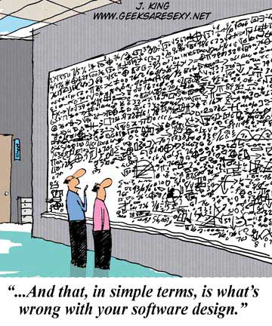
C+14 Concepts: “Terse Notation”
Better:
template<Forward_iterator For,
Forward_iterator For2,
Output_iterator Out>
requires Mergeable<For,For2,Out>()
void merge(For p, For q, For2 p2, For2 q2, Out p);
Quite readable

Slide 21
C+14 Concepts: “Terse Notation”
Better still:
Mergeable{For,For2,Out}
void merge(For p, For q, For2 p2, For2 q2, Out p);
The
concept-name { identifier-list }
notation introduces constrained names

Slide 22
C+14 Concepts: “Terse Notation”
Now we just need to define Mergeable:
template<typename T1,T2,T3>
concept bool Mergeable()
{
return Forward_iterator<For>()
&& Forward_iterator<For2>()
&& Output_iterator<Out>()
&& Assignable<Value_type<For>,Value_type<Out>>()
&& Assignable<Value_type<For2,Value_type<Out>>()
&& Comparable<Value_type<For>,Value_type<For2>>();
}
It’s just a predicate

Slide 23
“Paradigms”
Much of the distinction between object-oriented programming, generic programming, and “conventional programming” is an illusion
based on a focus on language features
incomplete support for a synthesis of techniques
The distinction does harm
by limiting programmers, forcing workarounds
void draw_all(Container& c) // is this OOP, GP, or conventional?
{
for_each(c, [](Shape* p) { p->draw(); } );
}

Slide 24
Reading
A. Sutton, B. Stroustrup, G. Dos Reis: Concepts Lite: Constraining Templates with Predicates. N3580. (current draft)
B. Stroustrup and A. Sutton: A Concept Design for the STL. N3351==12-0041. (“Palo Alto TR”)
Andrew Sutton and Bjarne Stroustrup: Design of Concept Libraries for C++. Proc. SLE 2011 (International Conference on Software Language Engineering). July 2011.

Slide 25


Questions?
C++: A light-weight abstraction programming language
Key strengths:
software infrastructure
resource-constrained applications
Practice type-rich programming

